Slide 1
Content Security Policy (CSP)
Solving XSS once and for all

Slide 2

Content Security Policy in a nutshell
Set of rules governing the types of content that can be loaded and executed on the browser
Basically a whitelist of scripts enforced on browser
Defined via an HTTP header or <meta /> tag

Slide 3

CSP Adoption
Browser support [1]
Standard was published in 2014 and quickly picked up by major browsers
1.0 Available (Global: 91.74%, Australia: 97.08%)
2.0 Available (Global: 71.16%, Australia: 79.85%)
3.0 Under development
Global Usage [2]
About 3.7% of URLs
About 0.16% of domains
[1]: http://caniuse.com/
[2]: Weichselbaum, Lukas, et al. "Csp is dead, long live csp! on the insecurity of whitelists and the future of content security policy." Proceedings of the 2016 ACM SIGSAC Conference on Computer and Communications Security. ACM, 2016.

Slide 4
CONTENT SECURITY POLICY
ANSWER TO THE ULTIMATE
QUESTION OF XSS. NOT!
Additional layer of protection
not a replacement

Slide 5
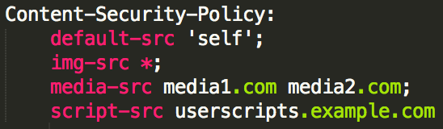
What does it look like?

Slide 6
Some CSP directives
default-src: fallback for the other fetch directives
script-src: JavaScript files
connect-src: XMLHttpRequest, Fetch, WebSocket, ...
style-src: stylesheets
img-src: images and favicons
font-src: @font-face
media-src: <audio> and <video>
object-src: <object>, <embed> and <applet>
worker-src: Worker, SharedWorker, or ServiceWorker scripts
child-src: web workers and nested browsing contexts e.g. <frame> and <iframe>
manifest-src: application manifest files

Slide 7
Demo time
Step08

Slide 8
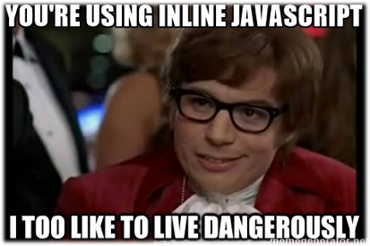
What about inline scrIPts?
If you like to live dangerously:
Use ‘unsafe-inline’ (terrible idea!)
Whitelist every inline script (including XSS)
Use nonce (for dynamic pages)
NOTE: nonce MUST change for each request
Use hash (for static pages)

Slide 9
Demo time
Step11

Slide 10
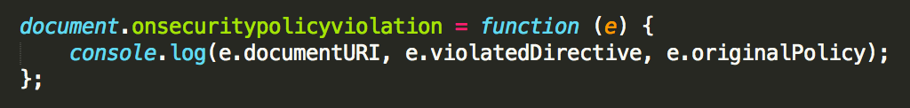
Reporting
Configure a report-uri to receive CSP exceptions
Can be “Report-Only” mode
Get the report but don’t block anything
Risk-free way of getting started with CSP
Violations can be handled on client-side

Slide 11
Demo time
Step13

Slide 12
Questions?

Slide 13
